Slide 1
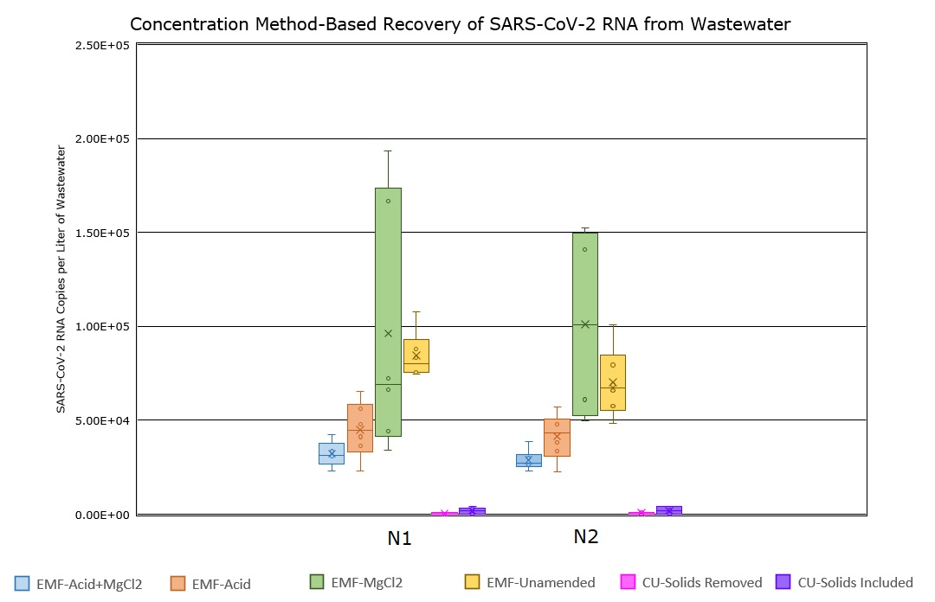
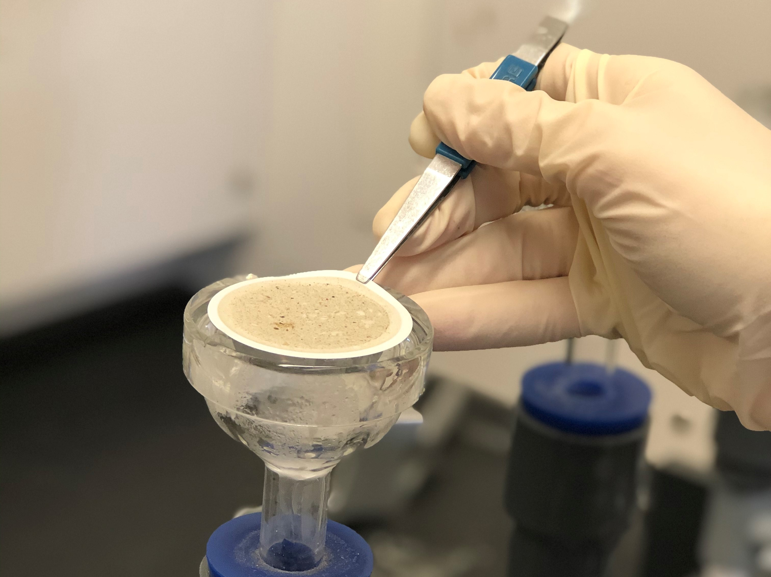

Abstract
A Comparison of Concentration Methods for SARS-CoV-2 RNA in Wastewater for Use in Sewershed Surveillance
Discussion
Government agencies and municipal utilities have begun a nationwide surveillance of wastewater for SARS-CoV-2 as a supplement to clinical data, though the best way to detect the virus is still unclear. This comparison of different methods for concentrating viral RNA to detectable quantities using SARS-CoV-2 RNA will help explain the strengths/weaknesses of commonly used methods and shed light on the unique characteristics of the virus that may make it behave differently from common surrogates during the concentration step.
Centrifugal ultrafiltration performed poorly compared to electronegative membrane filtration, in both the solids included and solids removed implementations.
While MgCl₂ performed better in some trials, the results were highly varied.
The unamended wastewater had consistently better recoveries than the method with acid and MgCl₂.
This discovery changed the concentration method currently used at Clean Water Services from electronegative membrane filtration with acid and MgCl₂ added to electronegative membrane filtration with unamended wastewater.
This saves time spent on concentration step (reduces by about 30 minutes per 6 samples).
Wastewater-based epidemiology
Looking Forward
Viral shedding in feces of patients infected with COVID-19 allows for location of hotspots within communities and directs health resources to areas with potential for most impact.
Asymptomatic individuals also shed viral material, helping to account for “hidden” infections.⁵
Shedding occurs before symptoms begin (up to 14 days before), so therein lies potential as early-warning indicator for public health officials.^{6,7}
Optimize and perform concentration with the PEG precipitation methods.
Continued method optimization through experience and papers released by wastewater-based epidemiology scientific community.
Further evaluation/use of surrogate viruses and spike tests.
Determine how/if recovery efficiencies differ between SARS-CoV-2 and its commonly used surrogate viruses.
References
Figure 1. The comparison of the different implementations of the electronegative membrane filtration method (EMF) with (a) acid and MgCl₂ addition, (b) acid addition, (c) MgCl₂ addition and (d) no addition and ultrafiltration with Centricon Plus-70 centrifugal devices (CU) with (a) large solids removed and (b) large solids included when considering the two different primer targets (N1 and N2) used in ddPCR.
(1) Ye, Y.; Ellenberg, R. M.; Graham, K. E.; Wigginton, K. R. Survivability, Partitioning, and Recovery of Enveloped Viruses in Untreated Municipal Wastewater. 2016. https://doi.org/10.1021/acs.est.6b00876.
(2) Ahmed, W.; Bertsch, P. M.; Bivins, A.; Bibby, K.; Farkas, K.; Gathercole, A.; Haramoto, E.; Gyawali, P.; Korajkic, A.; McMinn, B. R.; Mueller, J. F.; Simpson, S. L.; Smith, W. J. M.; Symonds, E. M.; Thomas, K. V.; Verhagen, R.; Kitajima, M. Comparison of Virus Concentration Methods for the RT-QPCR-Based Recovery of Murine Hepatitis Virus, a Surrogate for SARS-CoV-2 from Untreated Wastewater. Sci. Total Environ. 2020, 739, 139960. https://doi.org/10.1016/j.scitotenv.2020.139960.
(3) Foladori, P.; Cutrupi, F.; Segata, N.; Manara, S.; Pinto, F.; Malpei, F.; Bruni, L.; La Rosa, G. SARS-CoV-2 from Faeces to Wastewater Treatment: What Do We Know? A Review. Sci. Total Environ. 2020, 743, 140444. https://doi.org/10.1016/j.scitotenv.2020.140444.
(4) Kitajima, M.; Ahmed, W.; Bibby, K.; Carducci, A.; Gerba, C. P.; Hamilton, K. A.; Haramoto, E.; Rose, J. B. SARS-CoV-2 in Wastewater: State of the Knowledge and Research Needs. Sci. Total Environ. 2020, 139076–139076. https://doi.org/10.1016/J.SCITOTENV.2020.139076.
(5) Randazzo, W.; Truchado, P.; Ferrando, E. C.; Simon, P.; Allende, A.; Sanchez, G. SARS-CoV-2 RNA Titers in Wastewater Anticipated COVID-19 Occurrence in a Low Prevalence Area. medRxiv 2020, 181, 2020.04.22.20075200-2020.04.22.20075200. https://doi.org/10.1101/2020.04.22.20075200.
(6) Peccia, J.; Zulli, A.; Brackney, D. E.; Grubaugh, N. D.; Kaplan, E. H.; Casanovas-Massana, A.; Ko, A. I.; Malik, A. A.; Wang, D.; Wang, M.; Weinberger, D. M.; Omer, S. B. SARS-CoV-2 RNA Concentrations in Primary Municipal Sewage Sludge as a Leading Indicator of COVID-19 Outbreak Dynamics. https://doi.org/10.1101/2020.05.19.20105999.
(7) Wu, F.; Xiao, A.; Zhang, J.; Moniz, K.; Endo, N.; Armas, F.; Bonneau, R.; Brown, M. A.; Bushman, M.; Chai, P. R.; Duvallet, C.; Erickson, T. B.; Foppe, K.; Ghaeli, N.; Gu, X.; Hanage, W. P.; Huang, K. H.; Lee, W. L.; Matus, M.; McElroy, K. A.; Nagler, J.; Rhode, S. F.; Santillana, M.; Tucker, J. A.; Wuertz, S.; Zhao, S.; Thompson, J.; Alm, E. J. SARS-CoV-2 Titers in Wastewater Foreshadow Dynamics and Clinical Presentation of New COVID-19 Cases. medRxiv 2020. https://doi.org/10.1101/2020.06.15.20117747.
Viral Concentration
METHODS/Results
The first step in quantifying viral load of SARS-CoV-2 in wastewater is the concentration of the virus from a large volume of wastewater into a much smaller one.
SARS-CoV-2 viral load generally ranges from 10²-10⁶ genome copies per liter of wastewater.^{3,4}
Virus must be concentrated from wastewater into volumes suitable for viral RNA extraction and ddPCR (1-2 mL), the next steps in viral quantification.
Some of the commonly used concentration methods include: polyethylene glycol (PEG) precipitation^{1,2}, ultrafiltration with centrifugal devices^{1,2},ultracentrifugation¹, and electronegative membrane filtration², along with others.
There were three concentration methods chosen for this project. The first method is electronegative membrane filtration with a) acid and MgCl₂ added, b) with acid added, c) with MgCl₂ added, d) nothing added, meaning unamended wastewater.
The second method chosen was centrifugal ultrafiltration with Centricon Plus-70 centrifugal devices (10 kDa cutoff). This was run in two implementations – a) with solids removed initially and b) no solids removal.
For the third method, PEG precipitation will include two different implementations with a) large wastewater solids removed through filtration, and b) viral extraction from solids. The method for concentration has been performed previously but still needs further optimization.
The different implementations for the last two methods are to determine if there will be noticeable viral partitioning to solids.
A WWTP influent with known detectable quantity of virus was used, with the goal of determining the recovery efficiency relative to other methods.
Electronegative membrane filtration

